Slide 1
GIT
Malchiel Ed Urias
1.
4.0

Slide 2
Content
1. What is Version Control
2. Why is Version Control and SCM important
3. Types of VCS or SCM systems
4. Git
5. What is Git
6. Git Platforms
7. Git Concepts
8. Git Commands
2.
4.0

Slide 3
Version Control Systems
Version Control Systems are software that can track and manage changes to files and other digital assets. They enable teams of multiple developers work simultaneously and prevent loss of data.
Version Control Systems are sometimes referred to as Source Code Management systems.
Source Code Management enables software teams to IT resources (code and configurations) and keep records of the changes made to theses resources overtime, offering the ability to see the difference between two versions and rollback to a previous version.
3.
4.0

Slide 4
Why do we need VCS?
Maintaining a code base is relatively easy when working with just on developer or software engineer. When working with a team of engineers, it becomes more difficult to keep track of all the changes made by various developers and hold a single source of truth (the main, working code).
Problems that VCS can solve: - Data inconsistency (Overwriting the code of other developers)
Change conflicts
Breaking down velocity and speed of development
Reduced System and Code Maintainability
4.
4.0

Slide 5
Types of VCS
Problems that VCS can solve:
Local VCS: This maintains the versions and changes to files on your local system. It stores the changes as patches on a local databases in your computer where every patch contains the changes made since the last version.
Centralized VCS: All file versions are contained on a single server. Various developer can access this server, pull the files to their local system or push files for local to the remote central VCS server. Examples of this kind of VCS; Microsoft TFS, Apache SVN
Distributed VCS: With distributed version control systems, developers maintain a full mirror of the remote repository on their local workstation or computers instead of simply checking out the latest snapshot of the files from the server. This way, everyone collaborating on a project owns a local copy of the entire project, i.e. owns their own local database with their own complete history
4.
4.0

Slide 6

GIT
Git is a version control system.
It was created by Linus Torvalds in 2005, and has been maintained by Junio Hamano since then.
Remember Linus Torvalds?
Linux - 1991
Git - 2005
6.
4.0

Slide 7



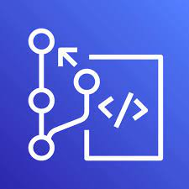
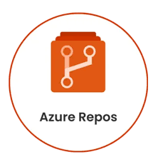
Git Platforms
7.
4.0

Slide 8
Git Concepts
1. Branch: A parallel version of the code within a Git repository, allowing for separate development and experimentation.
2. Pull/Push: The process of uploading changes from a local to remote repository (pushing) or downloading changes from a remote repository to a local repository (pulling)
3. Clone/Fork:
When you fork a Repo, you are creating an independent copy of it on a hosting platform like GitHub. The forked repo can be modified independently of the original.
When you clone a repository, you create an exact replica of the entire repository, including its entire history, branches, and commits on your local machine.
4. Merge: The process of combining changes from one branch into another
5. Pull Request: A request made by a developer to merge their changes into another branch, often used for code review.
6. CI/CD: Automating the process of building, testing, and deploying code changes. Usually done after code has been merged into the main (or master) branch
9.
4.0

Slide 9
Git Commands
1. git branch
2. git checkout
3. git status
4. git add
5. git push
6. git pull
7. git logs
8. git init
9. git config
10. git merge
11. git remote
12. git reset
13. git revert
14. git fetch
9.
4.0

Slide 10
Branching Strategy
A branching strategy is the system by which a development team writes, merges and deploys code in the code repository. It consists of the rules and policies that help multiple developers to interact with the same codebase in an organized manner.
Branching Strategies help developers to prevent merge conflicts with can greatly impact the speed and seemelessness of the software development process
Merging refers to combining changes from one branch into another branch.
Merge conflicts occur when a developer makes a change to a file and another developer makes a change to the same file and both try it combine that change into a branch.
9.
4.0

Slide 11
Common Branching Strategies
Gitflow
Github Flow
GitLab Flow
Trunk Based Development
9.
4.0

Slide 12
Gitflow Branching Strategy
This is a common branching strategy which encourages parallel development, which is multiple developers working together on different feature of the application on separate branches. A feature branch is created from a master branch and merged back into the master when development on the feature is complete.
Some of the types of branches that can be seen when using Gitfloe are:
Master Branch: This is the branch for production ready code
Dev Branch: For ongoing development code. Usually points to dev environment
Feature Branch: Checked out of the dev branch to include new features
Release Branch: This holds code that is ready to be merged into the master branch for a new version of new major release or update to the production code or app
Hotfix Branch: Branch for addressing issue or other bugs which development continues on the main branches
Note: The Master Branch and Dev Brain are the two main long-lived branches that last through the lifecycle of the application
9.
4.0

Slide 13
GitHub Flow
This strategy is a much simpler one to Gitflow. It is ideal for smaller teams or personal projects. The main goal of this system is to maintain a single master branch and only branch out to develop features before merging back into the main branch.
This flow has only two branch types:
Master: Holds the most recent and stable production code
Feature: Stemmed out of the main branch to crete new features or fix issue and added back into the main branch upon completion
9.
4.0

Slide 14
GitLab Flow
This strategy, designed for GitLab users, is another alternative to the Gitflow. It is more robust than the GitHub flow and consists of a protected master branch, which contains the production code, and other branches.
Types of branches in GitLab flow: Master: Main production branch housing stable release ready code.
Develop: Contains new features and bug fixes.
Feature: Developers initiate feature branches from the develop branch to implement new features or address bugs and merged back upon completion
Release: The release branch serves as a staging area for integrating new features and bug fixes intended for the upcoming release. Upon completion, developers merge the changes from the release branch into both the develop and main branches.
9.
4.0

Slide 15
Trunk-based Development
In this strategy, developers maintain a master branch which should be ready for release at anytime. The main branch is the Single Source of Truth (SSOT) which mean that it is exactly what is running on the production application. Branches are created to develop on feature and are merged upon completion. Trunk Based Development is characterized by a single long lived branch.
The goal of this strategy is to make frequent, smaller changes and to limit long-lasting branches.
This strategy enables continuous integration and delivery, making it an attractive choice for teams aiming to release updates swiftly and frequently
9.
4.0

Slide 16
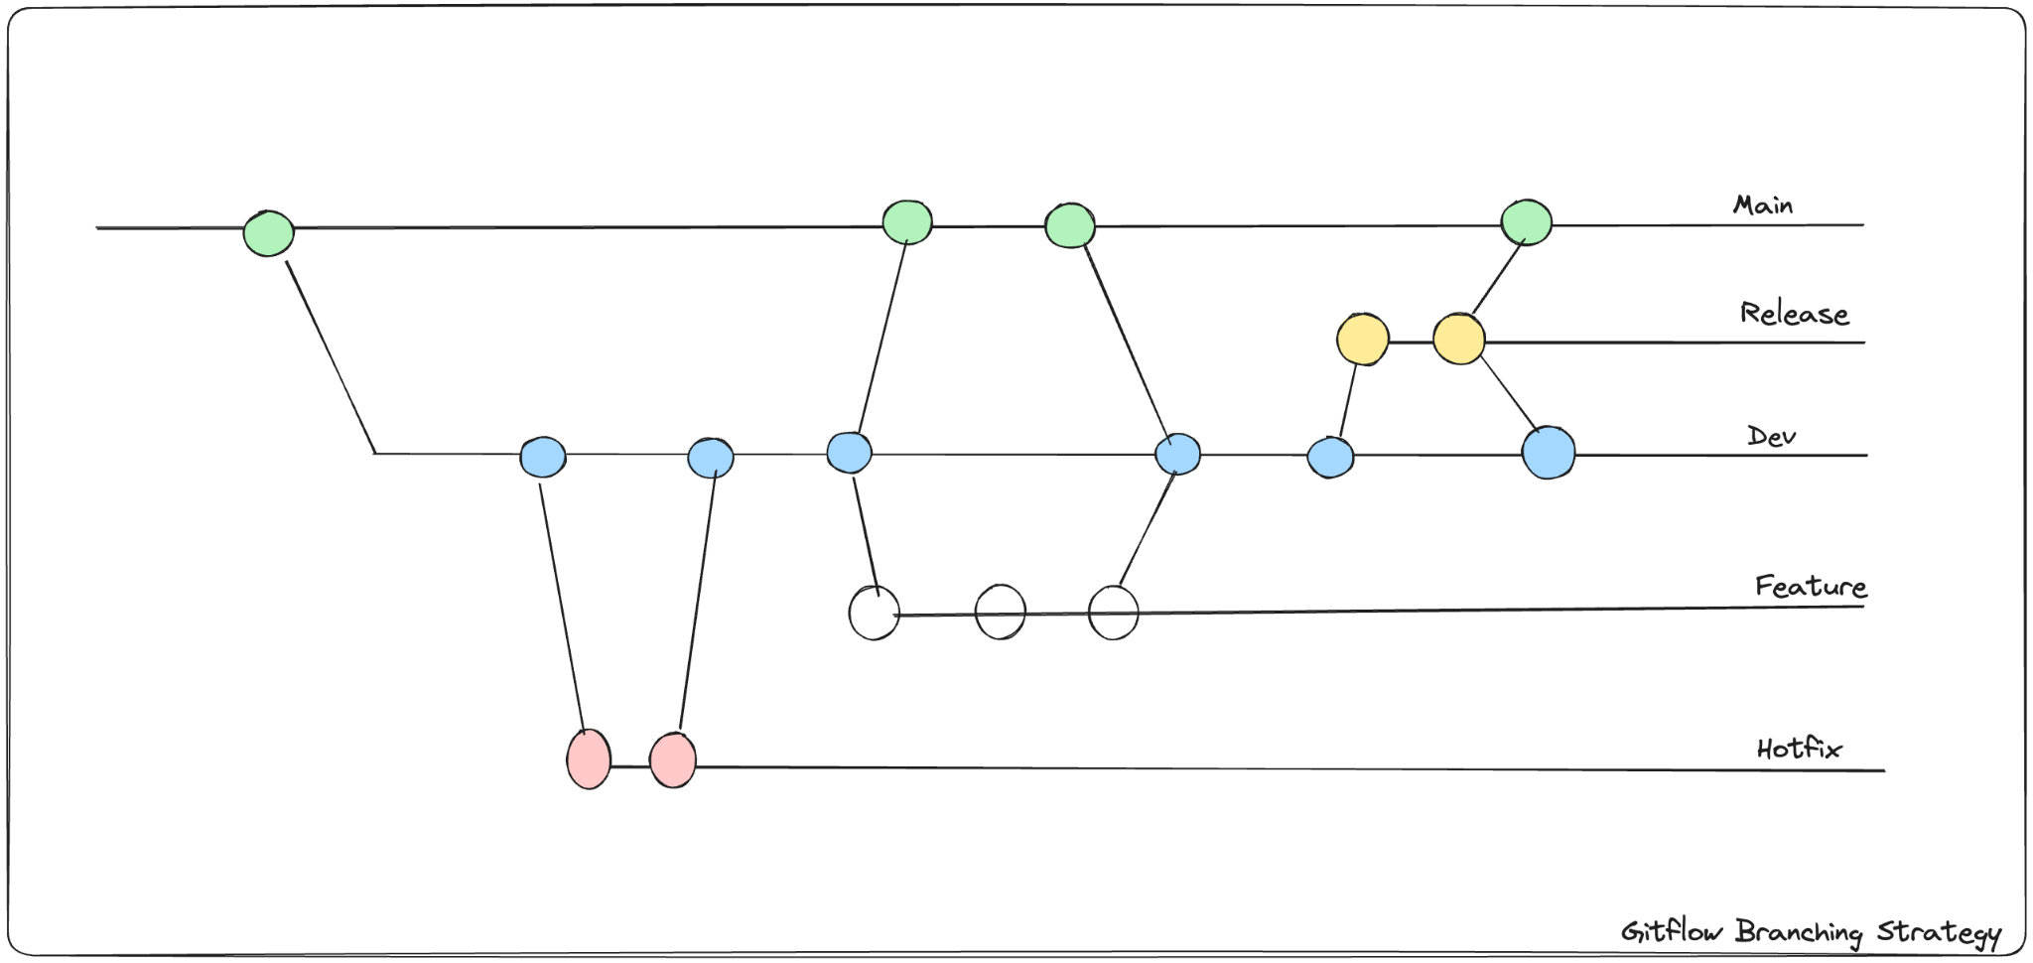
Gitflow
7.
4.0

Slide 17
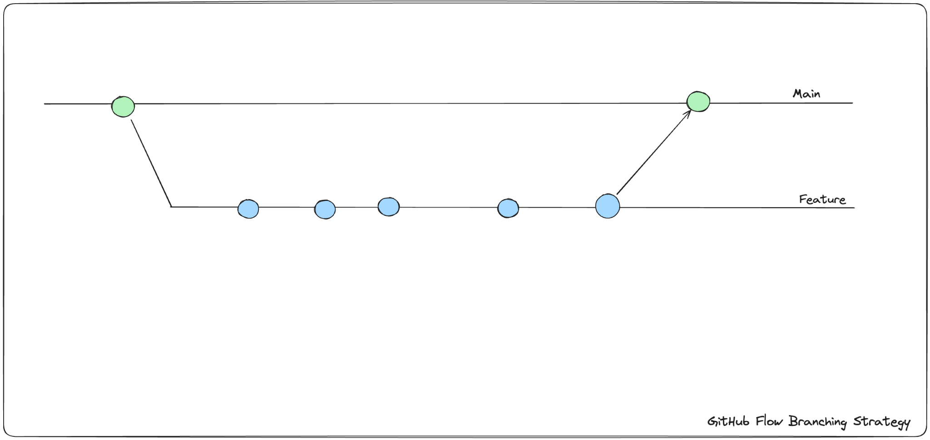
GitHub Flow
7.
4.0

Slide 18
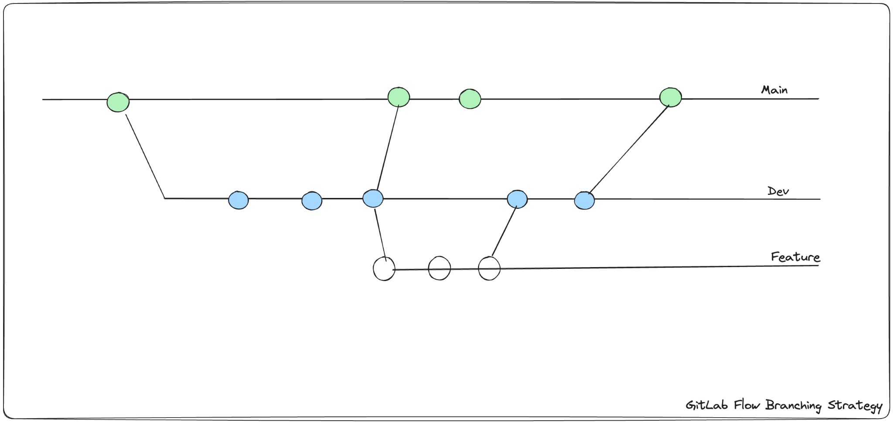
GitLab Flow
7.
4.0

Slide 19
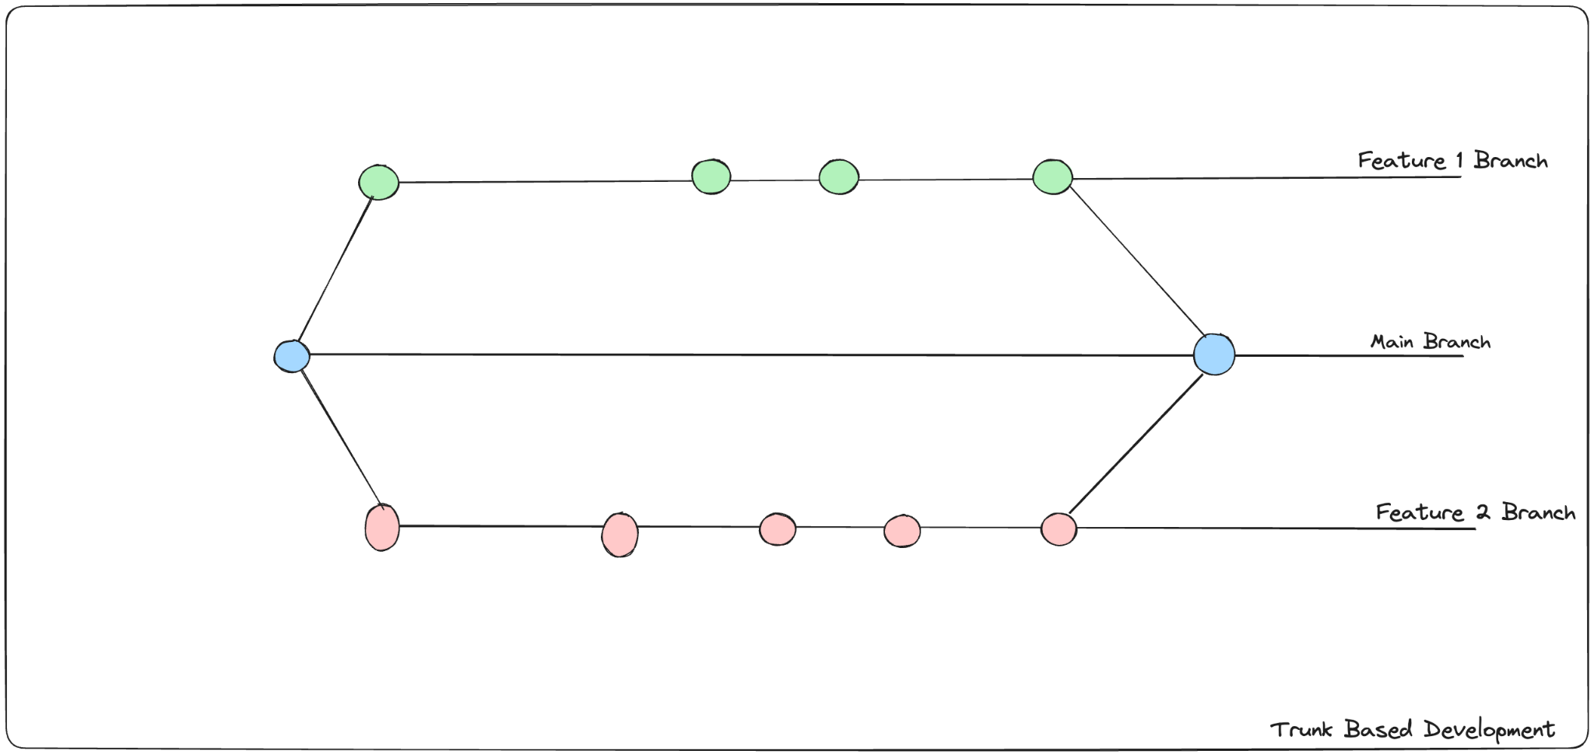
Trunk Based Development
7.
4.0

Slide 20
Questions?
16.
4.0

Slide 21
Hands-on!!!
16.
4.0

Slide 22
Exercises
Part 1
Create a GitHub repository
Connect GitHub to your Local Computer using SSH keys
Clone your repository
Add a README.md file and push to remote repository
Create new branch
Add a text file
Push to new branch
Part 2
Initialize KodeCamp directory on your local as a git repo
Create repo for KodeCamp on GitHub account
Create new branch called dev
Push files and folders to dev branch
Merge dev to main branch
9.
4.0
Notes:
git checkout main
git merge new-feature
git branch -d new-feature

Slide 23
THANK
YOU
17.
4.0

